Slide 1


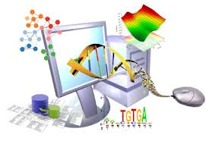
Gens, Ordinadors i Malalties
Biologia i Ordinadors al segle XXI
Àlex Sánchez
Unitat d’Estadística i Bioinformàtica VHIR
Departament d’Estadística Facultat de Biologia. UB

Slide 2
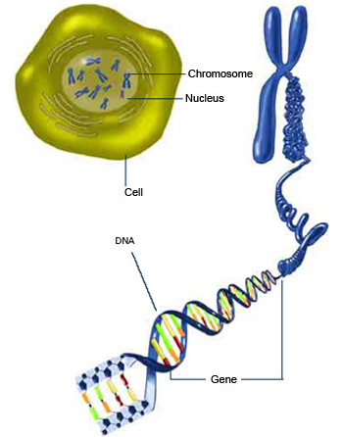
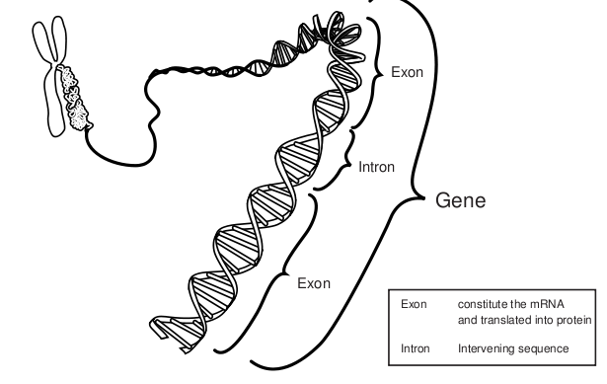
Genes are made of DNA

Slide 3
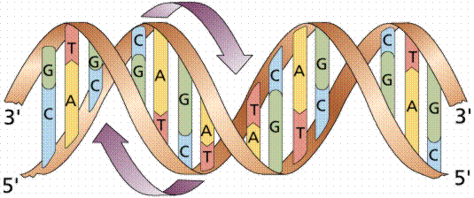
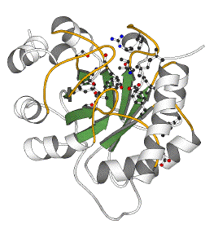
The Central Dogma of Molecular Biology
DNA
CCTGAGCCAACTATTGATGAA
transcription
mRNA
CCUGAGCCAACUAUUGAUGAA
translation
Protein
PEPTIDE

Slide 4
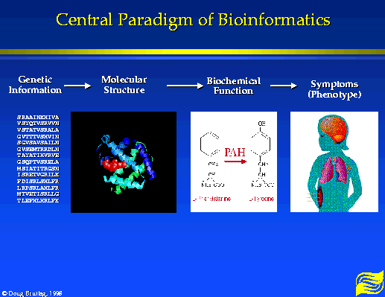

Slide 5
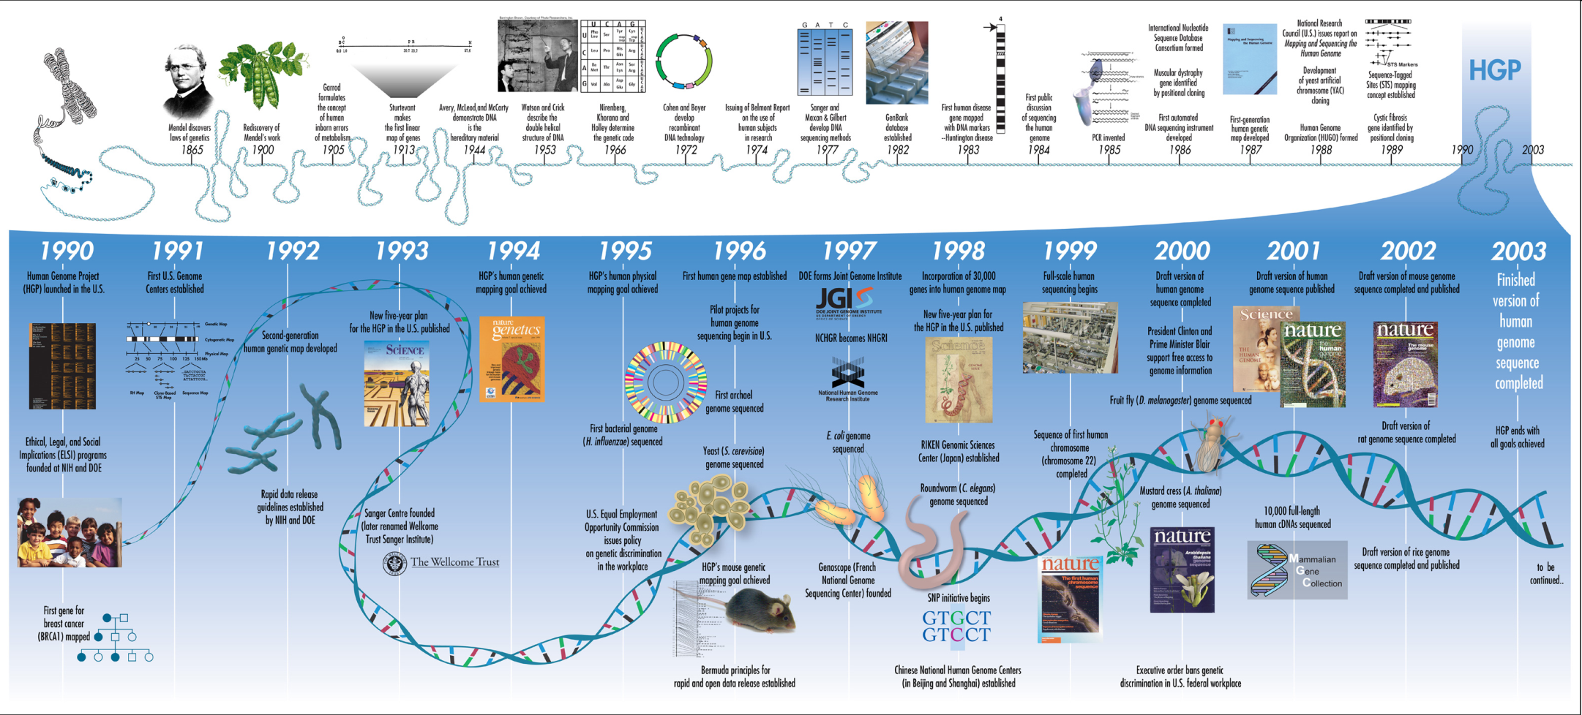
The human genome project

Slide 6
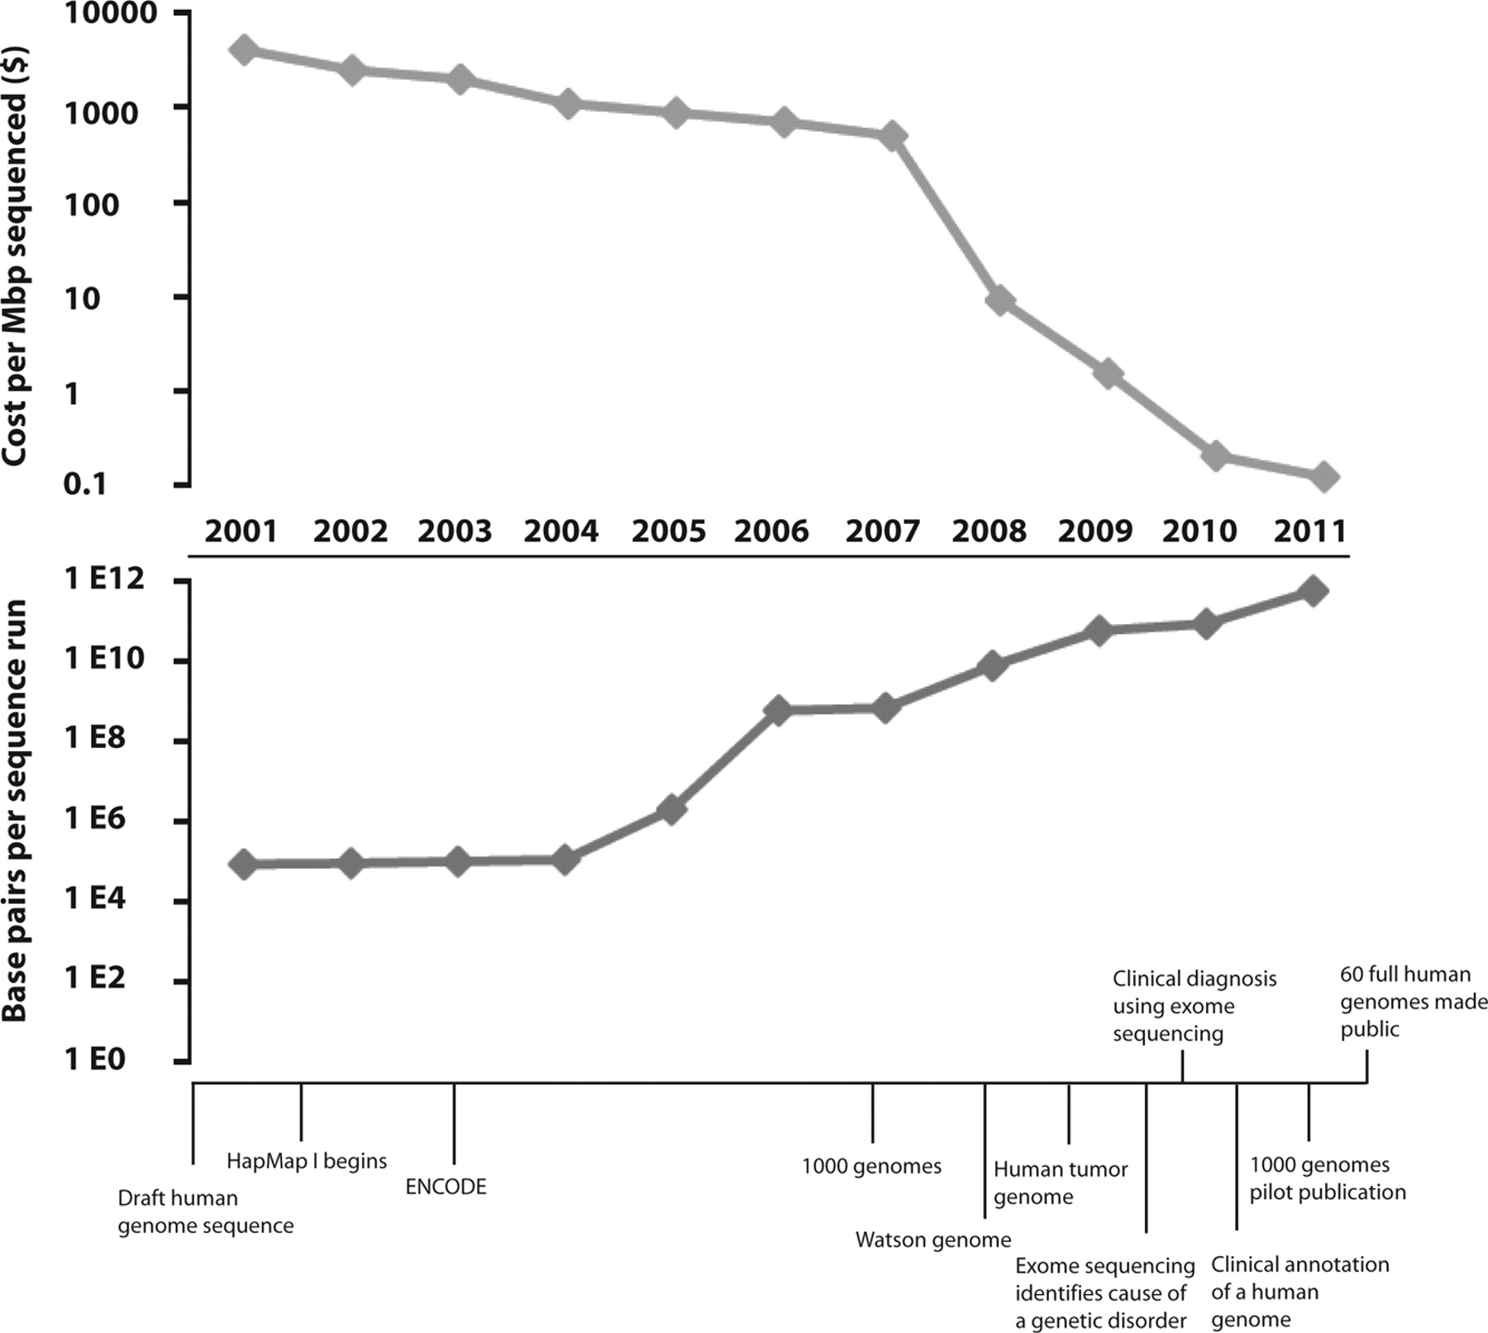
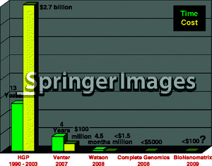
Decreasing costs & Increasing capabilities of genome sequencing
Project | Human Genome project | Venter’s genome | Watson’s genome | Anybody’s
Year | 2003 | 2007 | 2008 | 20012
Time needed | 13 years | 4 years | 4.5 months | 2 weeks
Cost | $27000 million | $ 100 million | < $1.5 million | <$10000
Coverage | 8-10x | 7.5x | 7.4x | 8x
# of scientists | 2800 | 31 | 27 | 1-3
# of Institutes | 16 | 5 | 2 | 1
# of Countries | 6 | 3 | 1 | 1

Slide 7
Diseases and genetic diseases
Traditionally : 3 types of diseases
1. genetically determined
2. environmentally determined
3. 1. + 2.
Today : distinctions are blurred
up to 20% of pediatric in-patients have genetic abnormality
about 50% of spontaneous abortuses have chromosomal aberration
only mutations that are not lethal are reservoir of genetic diseases

Slide 8
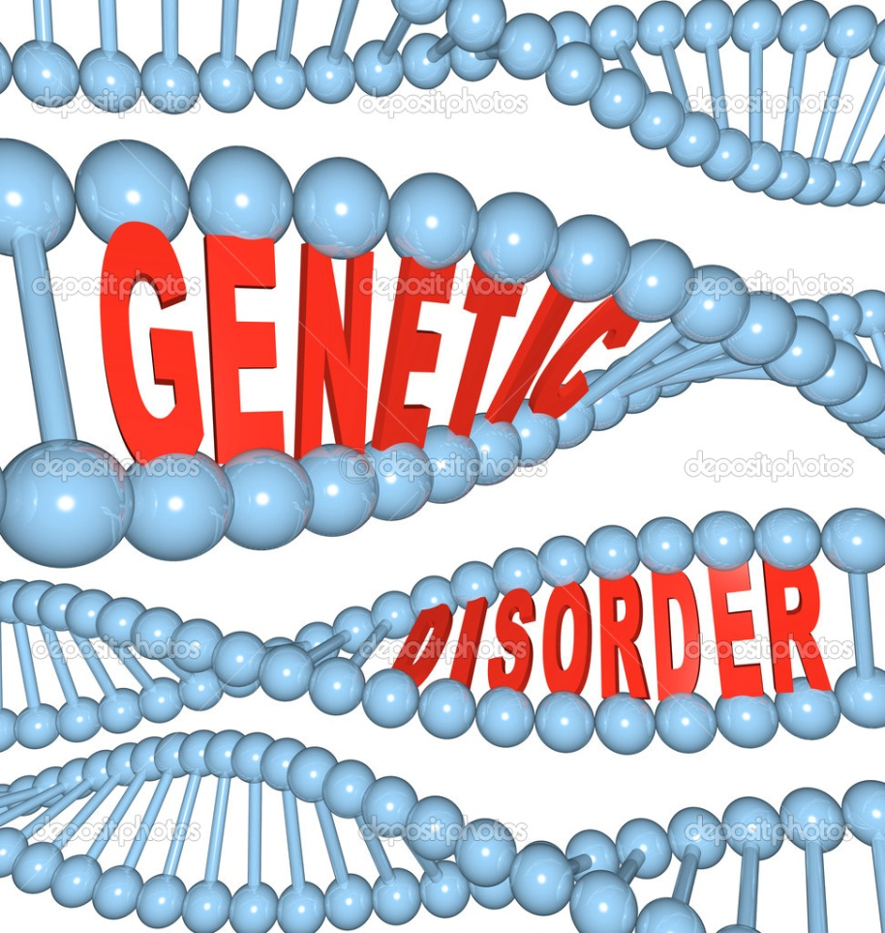
Genetic disease
Genetic disorders are caused by abnormalities in the genetic material.
Abnormalities can range from a small mutation in a single gene to the addition or subtraction of an entire chromosome or set of chromosomes.

Slide 9
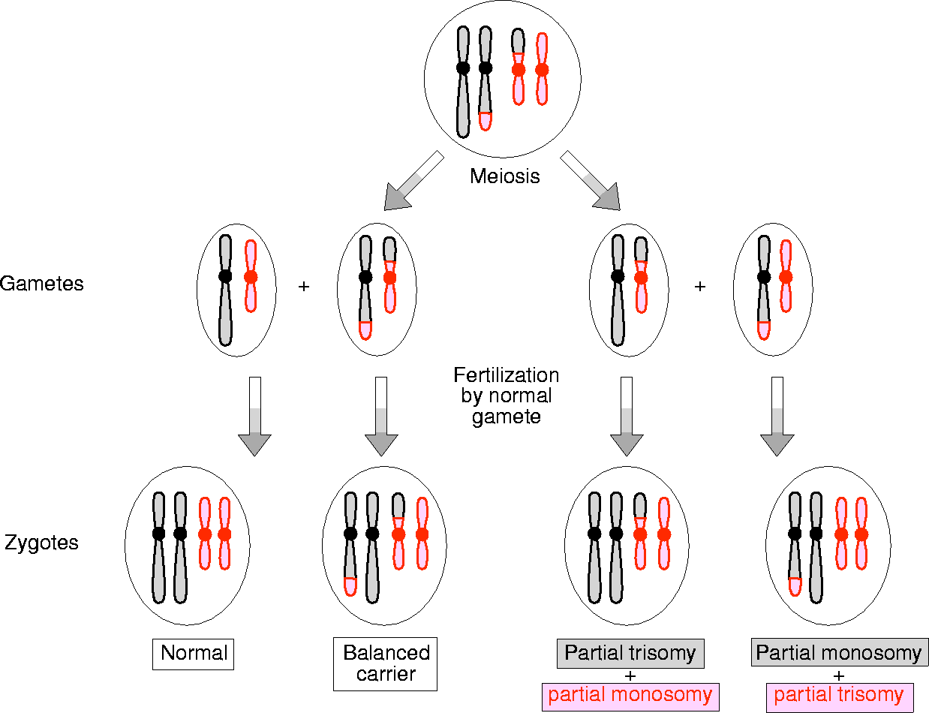
Classification of genetic disorders
Multifactorial
Single gene
Chromosomal
Mitochondrial
Somatic mutations (cancer)
+ environment
Male

Slide 10
Gene identification of inherited disease
Every gene has a specific task
Disease genes carry mutations, which change the protein, which alters the way the task is usually performed.
The mutation may be
within a gene/protein or
within a regulatory part of the genome that, e.g., affects the amount of protein being produced.
DISEASE

Slide 11
Modern approaches to disease gene identification and analysis
The release of genomic sequences, full-lenght cDNA sequences, of human and model organisms offer invaluable resources for studying genetic diseases.
It is not possible, however, to access such an impressive quantity of biological information without the use of powerful informatics resources
That is where bioinformatics enters the scene

Slide 12
The data explossion(s)
Bioinformatics has evolved in parallel with
The increase in biological data available
The ability to generate (and manage) them.
We distinguish (up to now) …
Pre-genomic age
Early post-genome age
Late post-genome age
12

Slide 13
The human genome project

Slide 14
THE EXPLOSIVE GROWTH OF DATA (as seen in 2010)
 | Then | There was | By 2010
Nucleotides | 32 years (1982) | 680338 pb (GenBank) | > Billions
Proteins | 32 years | 1500 | 300.000
SNPs | 22 years | hundreds | Millions
Expression | 16 years | A few genes | Thousands of studies based on thousands of genes
Genomes | 18 years | 0 organisms | A thousand Organisms
14

Slide 15
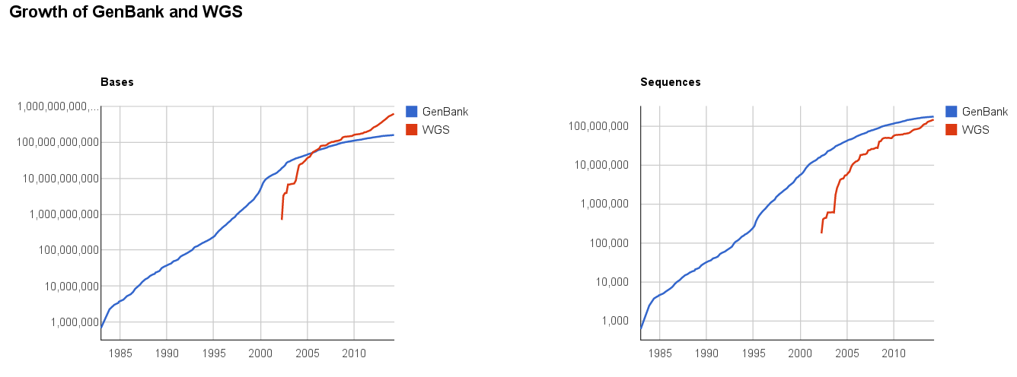
THE GROWTH OF GENBANK
15

Slide 16
NGS: (much) More per (much) less
http://www.genome.gov/sequencingcosts

Slide 17
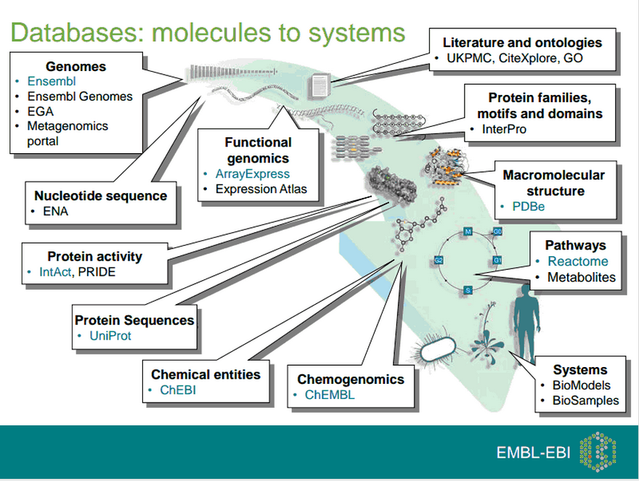
Today: a wealth of diverse information

Slide 18
BIOINFORMATICS
Born on the lookout for
the development of new technologies and
its application in the generation of huge amounts of data.
It is the interdisciplinary scientific field that develops methods for storing, retrieving, organizing and analyzing biological data.
18

Slide 19
BIOINFORMATICS AND INTERDISCIPLINARITY
Chemistry
Mathematics
Statistics
Biology
Molecular
biology
Bioinformatics
Computer
Science
Informatics
Medicine
Physics
19

Slide 20
THE SCOPES OF BIOINFORMATICS
Information organization
Databanks and databases
Algorithms and exploitation tools
Analysis and interpretation of experimental results
Genome analysis and sequencing
Comparative genomics
Gene expression and transcription
Proteomics, protein-protein interaction
Systems biology modeling
20

Slide 21
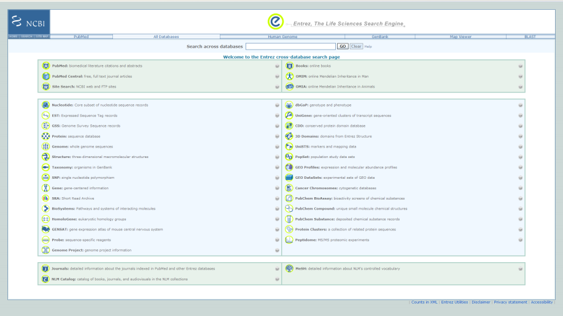
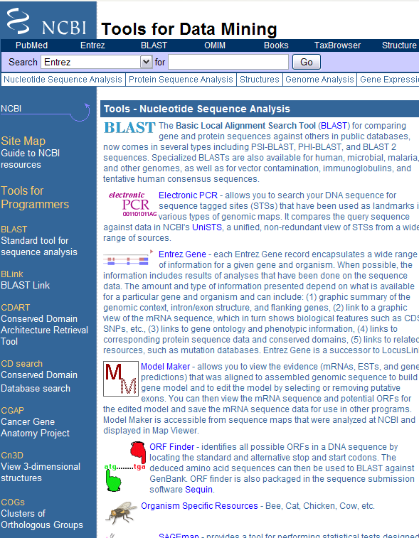
INFORMATION ORGANIZATION
21

Slide 22
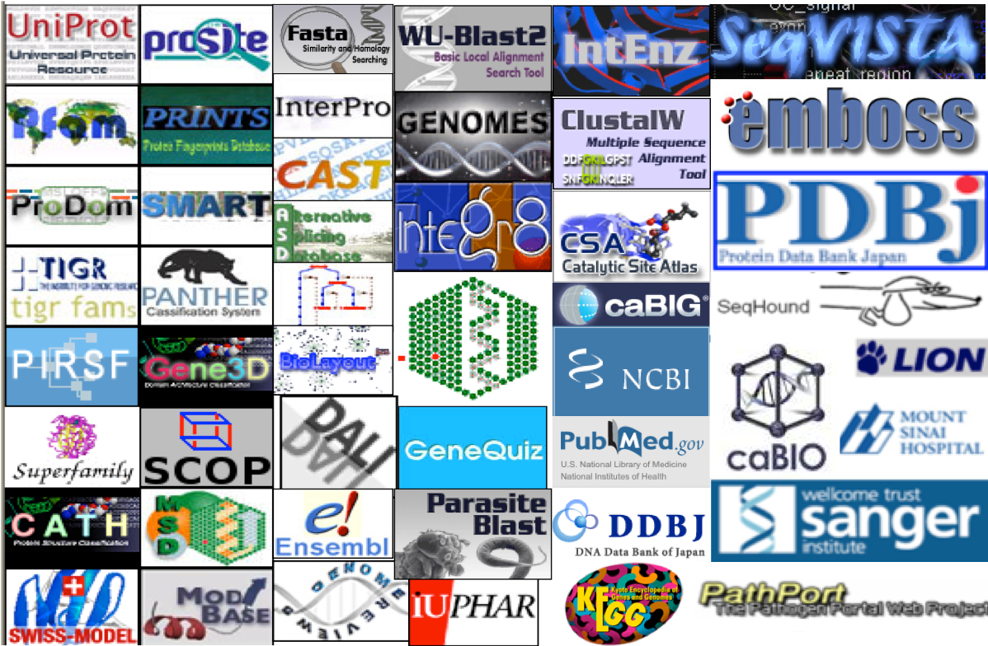

Slide 23
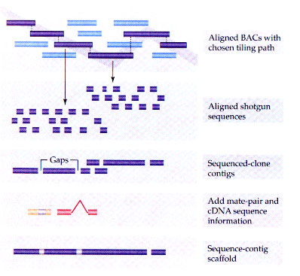
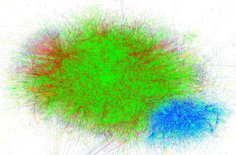
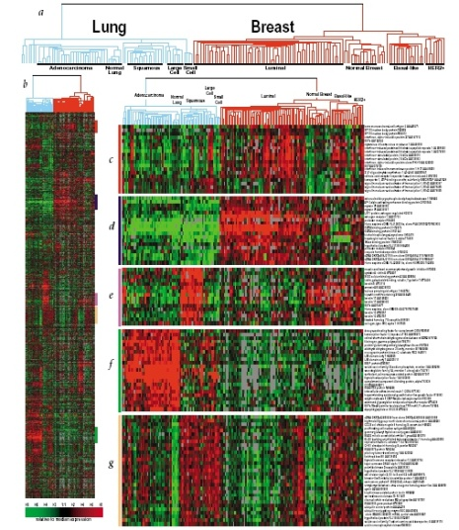
ANALYSIS AND INTERPRETATION
A G A G T TC T G C T C G
A G G G T T A T G C G C G
23

Slide 24

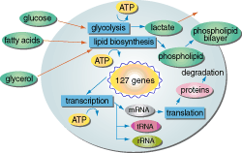
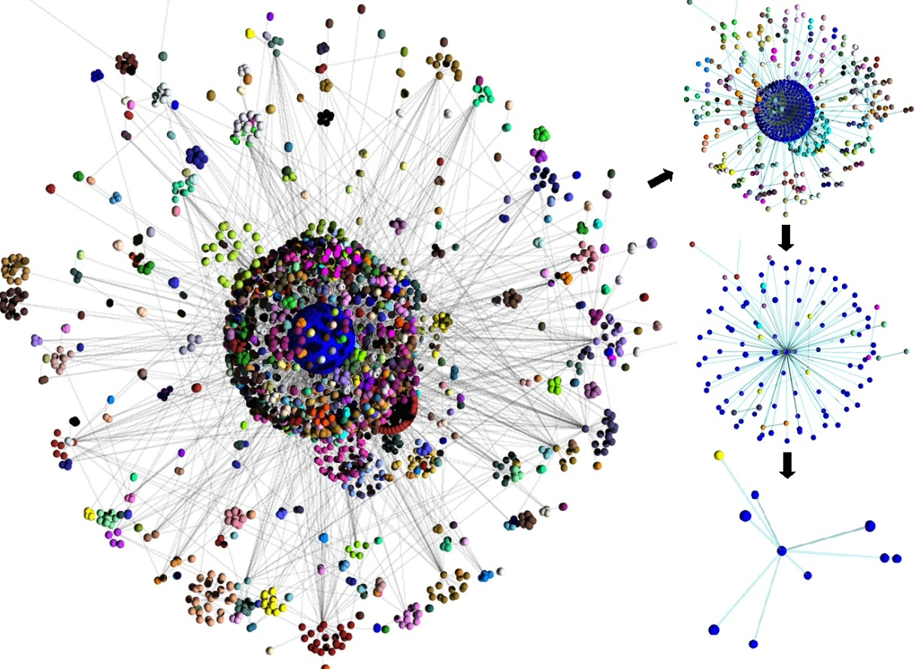
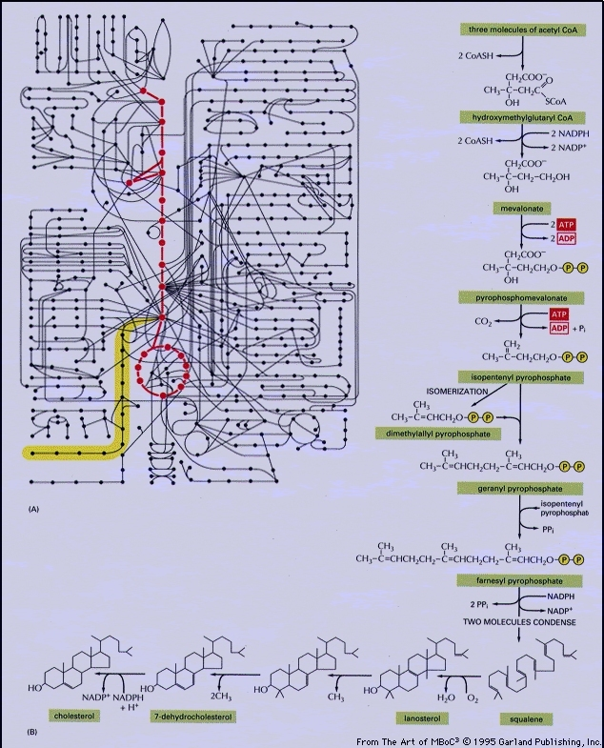
SYSTEMS BIOLOGY MODELING
24

Slide 25
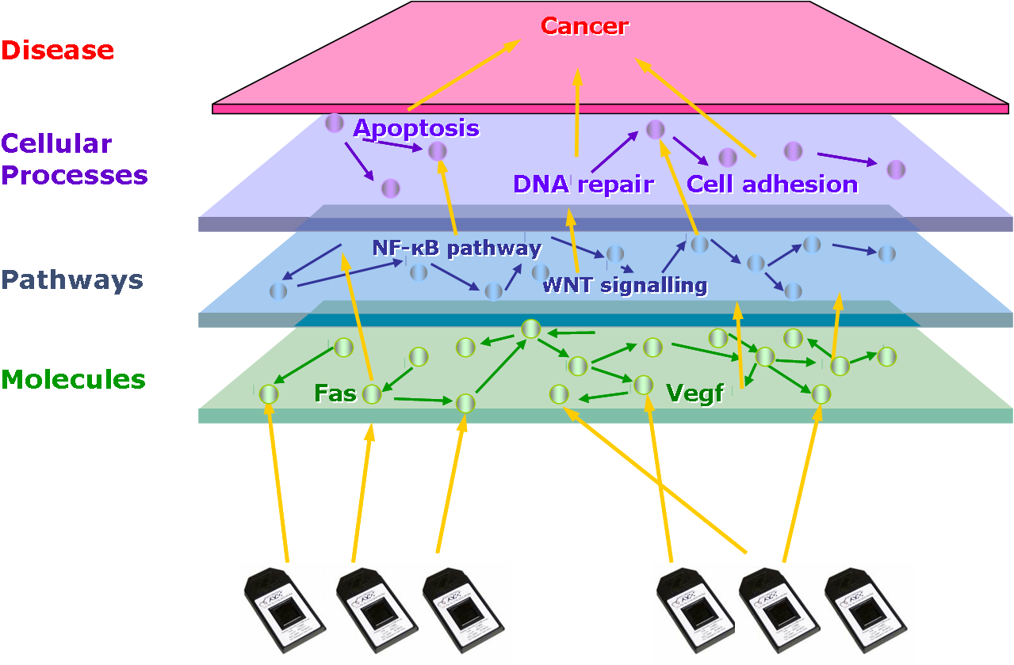
INTEGRATIVE BIOINFORMATICS
25

Slide 26
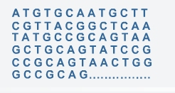
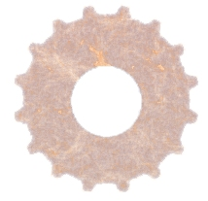
IN SUMMARY…
Bioinformatics tools and resources
Data
Knowledge
26

Slide 27
How does one do bioinformatics?
27

Slide 28
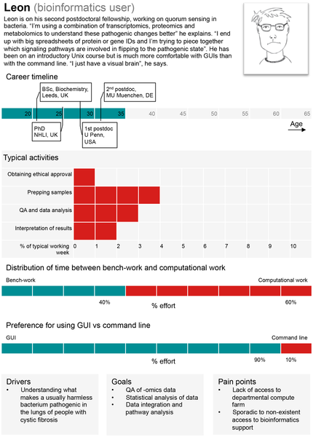

A typical “bioinformatics user.”
Welch L, Lewitter F, Schwartz R, Brooksbank C, et al. (2014) Bioinformatics Curriculum Guidelines: Toward a Definition of Core Competencies. PLoS Comput Biol 10(3): e1003496. doi:10.1371/journal.pcbi.1003496
http://www.ploscompbiol.org/article/info:doi/10.1371/journal.pcbi.1003496

Slide 29
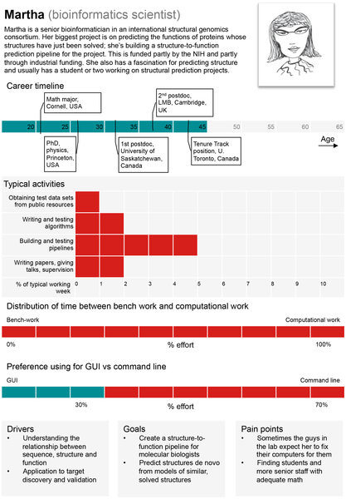
A typical “bioinformatics scientist.”
Welch L, Lewitter F, Schwartz R, Brooksbank C, et al. (2014) Bioinformatics Curriculum Guidelines: Toward a Definition of Core Competencies. PLoS Comput Biol 10(3): e1003496. doi:10.1371/journal.pcbi.1003496
http://www.ploscompbiol.org/article/info:doi/10.1371/journal.pcbi.1003496

Slide 30
Computer systems for Bioinformatics
Bioinformatics has been developped in environment which required …
Creating and accessing databases in the web
Creating and executing programs in the web
Installing and Managing web servers.
Ability of file text parsing and batch processing.
The need of developping and sharing tools between diverse systems and users.
Windows was not an option of choice
No console (or almost). Difficult to share with non-windows systems. Difficult to scale-up applications.
Unix/Linux best suited for this purpose

Slide 31
Bioinformatics “computer skills”
Some consensus on that these include:
SQL and knowledge of databases.
Perl or Python.
basic Linux.
basic bash shell scripting.
Some experience with Java or other “traditional languages”.
R + Bioconductor.

Slide 32
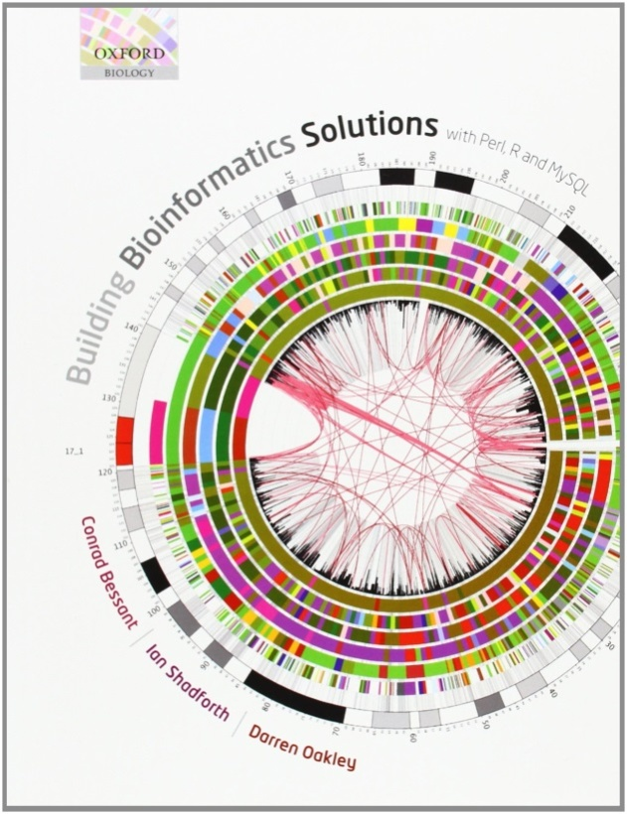
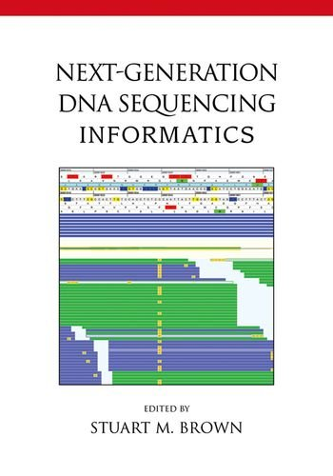
Some references

Slide 33
TO KNOW MORE
There are a lot of free courses and training activities:
EBI’s Online training and courses
NCBI’s tutorials
Local training courses
Introducción a la Bioinformática (Alex Sánchez, UEB/UB)
Invitació a la Bioinformàtica (Plataforma BioinfoUAB)
A great variety of rerefence books:
List of books on bioinformatics
Scientific Societies and Publications:
Bioinformatics, Briefings in Bioinformatics
International Society for Computational Biology
33

